Slide 1

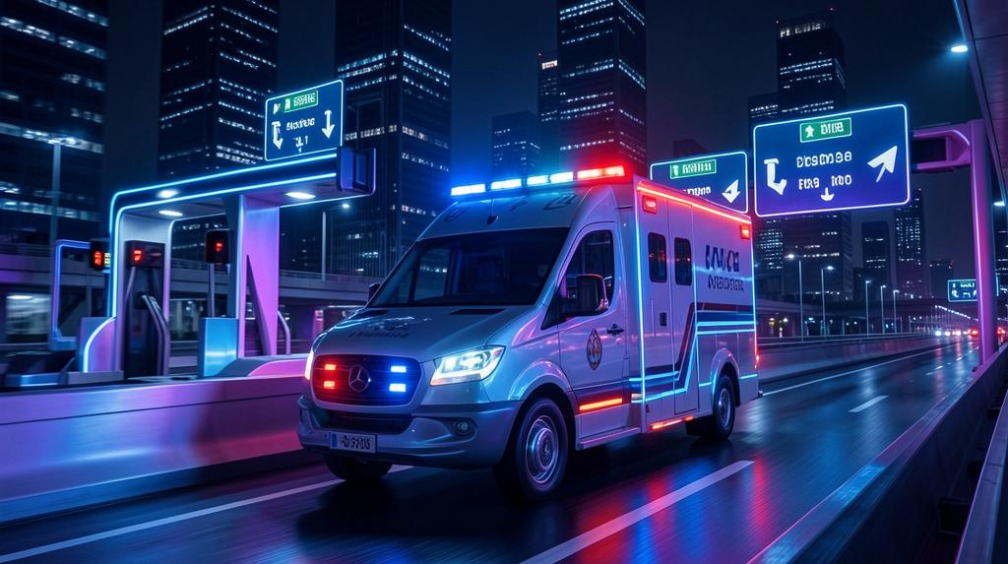

Smart Ambulance
NAME:- HRITIK SINGH & ROHIT KUMAR
ENR. NO. :-0201230163 & 0201230262
COURSE:- B.TECH(CSE)
TEAM :- LOCALHOST: 8080

Slide 2

Problem Statement
Ambulances face delays due to traffic
No real-time tracking
No accurate ETA

Slide 3

Solution
Live Ambulance tracking
Traffic-aware routing
ETA countdown to hospital

Slide 4
SITUATION & Goal
An ambulance equipped with a smart transmitter enters a 500–1000 m detection range, triggering the system to preempt traffic and toll controls.
Goal: enable automatic priority—traffic lights turn green, vehicles clear the path, and toll barriers open—to ensure uninterrupted ambulance transit.

Slide 5
Key Components
System elements: ambulance-mounted device, roadside receivers, traffic signal controller, toll gate actuator, and central coordination unit.
Core technologies include IoT integration, RF/GPS/GSM communication, and microcontroller platforms (Arduino/Node MCU) for real-time control and monitoring.

Slide 6
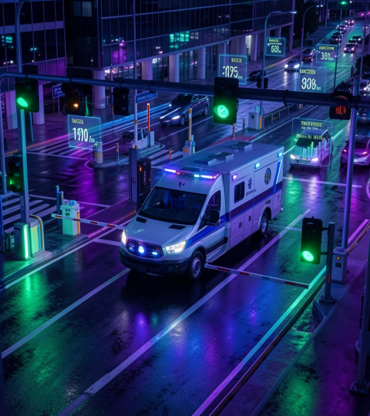
Expected Outcomes
Reduced ambulance response times and improved patient survival through automated priority routing.
System delivers quicker transit, fewer manual interventions, and measurable traffic disruption reduction.
Operational metrics: average delay cut, successful signal preempts, and toll bypass success rates.

Slide 7
Communication Flow
Ambulance device broadcasts position on entry to 500–1000 m range. Roadside units receive signal and notify traffic and toll controllers.
Controllers execute preemption: traffic lights turn green and toll barrier opens, enabling continuous passage.

Slide 8
Hardware ,Software & Technology
Core hardware: ambulance transmitter, roadside receivers, traffic controller interface, toll actuator, and central coordination unit.
Core Software: Frontend(React ,Google Maps JavaScript API ,SockJS,JavaScript) , Backend (Spring Boot ,Spring WebSocket , Java ,) Postman Usage(Used for API testing , POST /app/location , Send live GPS data , Test backend endpoints.

Slide 9
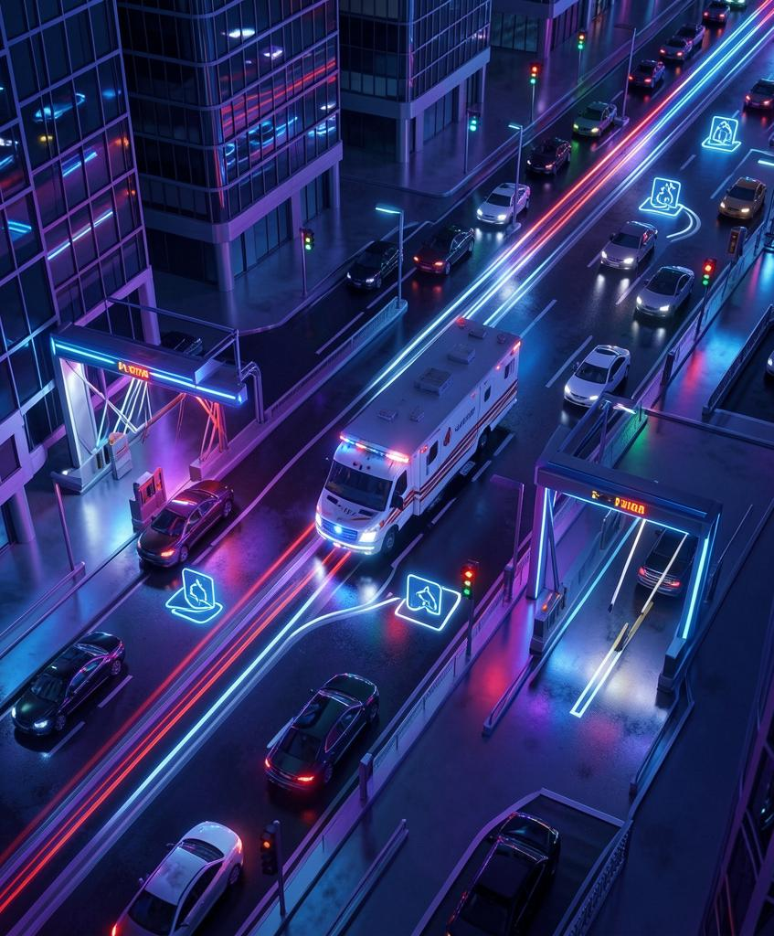
Visuals & Animations
Use semi-realistic top/3D city view with smooth ambulance motion, signal-wave effects, and blinking lights.
Animate traffic light change, vehicles clearing, and toll gate opening. Maintain bright blue/red/white palette and clear icons for readability.

Slide 10
Conclusions
Automated ambulance priority integrates communication, control, and visualization to save time and lives.
Pilot deployment can validate performance, with future AI enhancements for predictive routing and city-scale integration.

Slide 11
Thanks!

